Slide 1
Introduction to molecular mechanics
Lee-Ping Wang
Paul Nerenberg

Slide 2
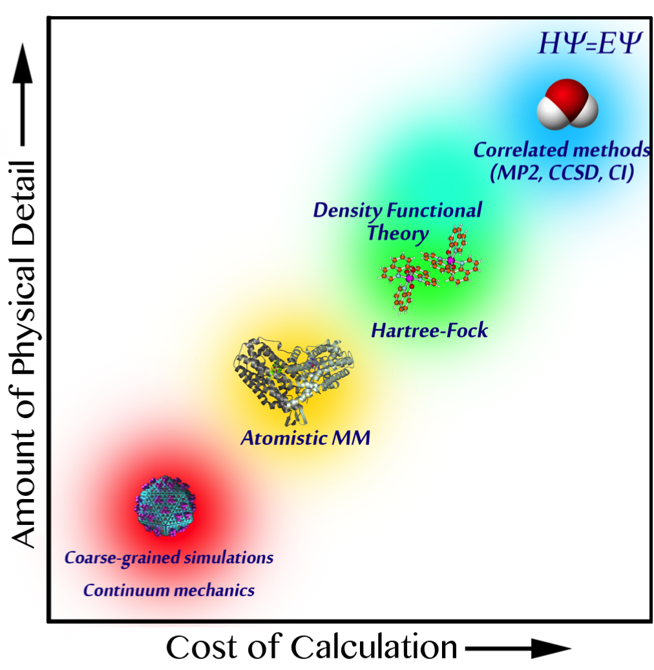
A bird’s eye view of computational chemistry
Computer simulations of molecules span a wide range of resolutions
More detailed theories can describe complex phenomena and offer higher accuracy
Less detailed theories allow for simulation of larger systems/longer timescales
Empirical force fields are the method of choice in the simulation of biomolecules
100 fs, 30 atoms: photochemistry
100 ps, 100 atoms: fast chemical reactions
1μs-1ms, 100k atoms: protein dynamics, drug binding
1 ms+, 1 million atoms: folding of large proteins, virus capsids

Slide 3
The Schrödinger equation
All ground-state quantum chemistry is based on the time-independent Schrödinger equation:
Kinetic energy operator
Nuclear repulsion
…just a number
Electron-nuclear attraction
Electron-electron repulsion
Electron wavefunction
Electronic energy
Born-Oppenheimer approximation: when solving for the electronic wavefunction, treat nuclei as static external potentials

Slide 4
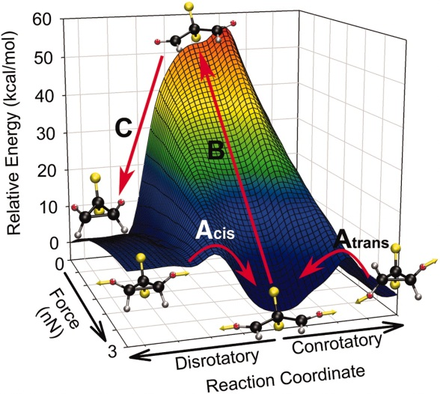
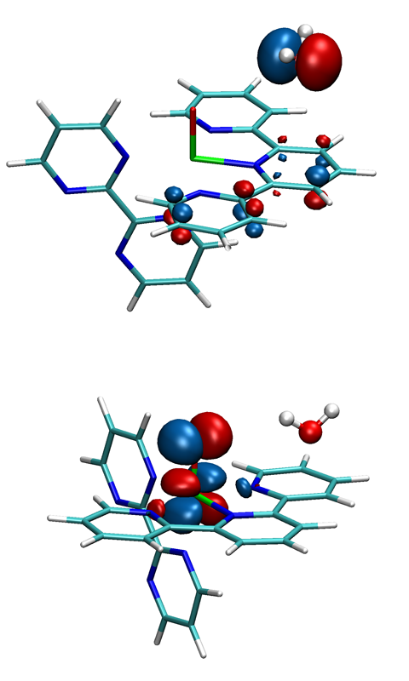
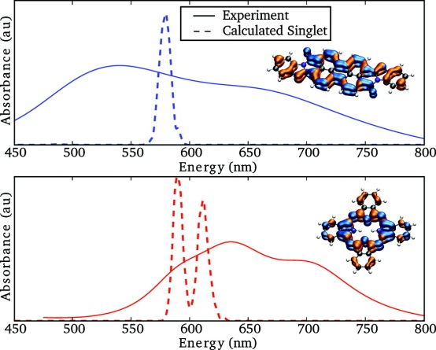
Useful results from quantum chemistry
Electronic structure
Molecular orbitals can provide a detailed explanation of reaction mechanisms
Spectra
Computing spectra helps us compare with experiment and study molecular interactions with light (may require time-dependent calculations for electrons)
Potential energy surface
Evaluating the potential energy and its gradients allows us to simulate how molecules move
HOMO
JM Lenhardt, et al. Science (2010).
LUMO
Wang, Wu, and Van Voorhis, Inorg Chem (2011).
Yost, Wang, and Van Voorhis J Phys Chem B (2011).

Slide 5
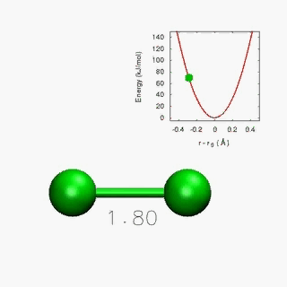
Approximate solutions to the SE
Schrödinger’s equation is nearly impossible to solve, so approximate methods are used.
Electron repulsion makes this problem difficult
Approach 1: Use approximate wavefunction forms (quantum chem.)
Approach 2: Use the electron density as the main variable
Approach 3: Approximate the energy using empirical functions
Slater determinant: wavefunction of noninteracting electrons for interacting system
Density functional theory: ground-state electron density contains all information in the ground-state wavefunction
Molecular mechanics: empirical functions and parameters describe the energy (e.g., harmonic oscillator for chemical bond)

Slide 6
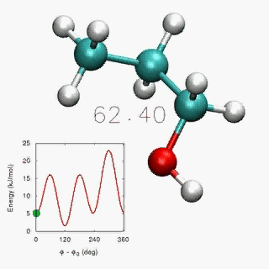
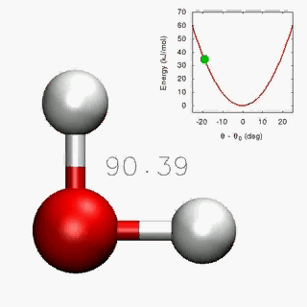
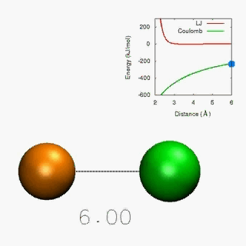
Force fields
Force fields are built from functional forms and empirical parameters
Interactions include bonded pairwise, 3-body, and 4-body interactions…
…as well as non-bonded pairwise interactions
Simulation accuracy depends critically on parameters

Slide 7
Force field functional forms (1/3)
Atoms are spheres of mass m_{i}, partial charge q_{i}, and van der Waals sort-of-size σ_{i}
Potential energy function (force field):
3
4
r_{ij}
7
8
θ
1
2
5
6
φ
l

Slide 8
Force field functional forms (2/3)
Non-trivial point #1: the combining/mixing
rules for pairwise vdW interactions.
Recap of Lennard-Jones potential for vdW interactions:
Two common mixing rule schemes for these interactions:
Lorentz (e.g., AMBER or CHARMM)
Berthelot
Berthelot, part deux (e.g., OPLS)

Slide 9
Force field functional forms (3/3)
Non-trivial point #2: how to move smoothly from 1-4 interactions to nonbonded interactions.
Numerous approaches to this problem…
AMBER/GAFF: scale 1-4 vdW interactions by 0.5; scale 1-4 electrostatic interactions by 0.833
CHARMM: don’t scale 1-4 interactions at all (used to be scale by 0.4)
OPLS: scale 1-4 interactions by 0.5

Slide 10
Force field parameterization (1/2)
Force fields are parameterized to compensate for their simplified description of reality.
Most models have incomplete physics:
Fixed point charges (no electronic polarization)
Classical mechanics (no isotope effects)
Fixed bond topology (no chemistry)
However, much can be recovered through parameterization:
“Increase” the partial charges to recover polarization effects
Tune vdW parameters to recover the experimental density
In many cases, force fields exceed the accuracy of quantum methods!

Slide 11
Force field parameterization (2/2)
A (typical) force field parameterization flow chart
bond stretch (1-2), angle (1-3), and torsion (1-4) parameters
ab initio: geometry optimization, vibrational analysis, torsion scan
partial atomic charges (1-4 and beyond)
ab initio: electrostatic potential calculation + charge fitting
vdW parameters
(1-4 and beyond)
classical MD simulations
torsion parameters redux (1-4)
linear combo of ab initio calcs (torsion energy profiles) and classical MD sims

Slide 12
Fixed-charge FF successes (bonded)
Before Optimization
ψ (degrees)
QM Energy (kcal/mol)
MM Energy (kcal/mol)
∆ MM-QM (kcal/mol)
φ (degrees)
After Optimization
L-P Wang et al. J Phys Chem B (2017).

Slide 13
Fixed-charge FF successes (nonbonded)
DE Chapman, et al. J Chem Theory Comput (2014).

Slide 14

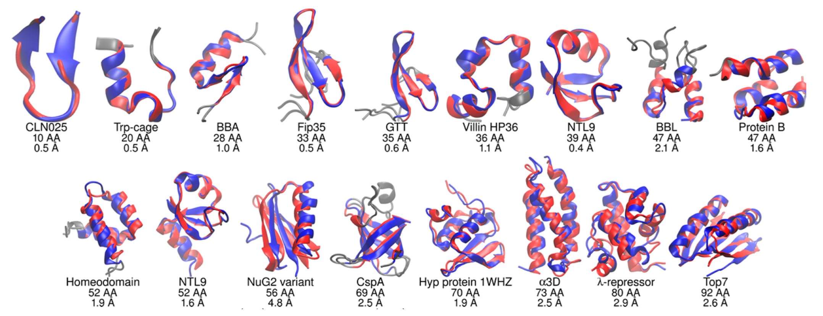
Fixed-charge FF successes (e’rybody)
H Nguyen, et al. JACS (2014).

Slide 15
Conclusions and future directions
Classical force fields have been able to successfully provide an atomistic description of a wide variety of chemical phenomena
Fixed-charge FFs have been (shockingly) useful…
…but limitations ultimately motivate move to polarizable FFs
Challenges/opportunities going forward:
What physics to include (e.g., polarizability, charge penetration)
Functional forms
New algorithms to increase speed and/or sampling
Parameterization strategies and data

